Slide 1



Developing NAU’s First Science Communication Course for Undergraduate Students
2024 NASA Space Grant Symposium
Kayla Blair and Dr. Lisa Chien

Slide 2
Why Science Communication?
Communication is the 2nd most important Career Readiness skill (NACE)
  The skills and knowledge developed by practicing science communication are applicable in all areas of life
“The science world needs young scientists who already, by the end of their undergraduate education, have developed an intuitive feel for the basic rules of narrative structure” (Houston We Have a Narrative)
Courses at NAU emphasis scientist-to-scientist communication
  Strongly differs from scientist-to-public communication
  Relies on the deficit model and not the dialogue model, which is makes for more productive communication (Reincke, 2020)

Slide 3
Developing the Course
Summer – Fall 2023

Slide 4
Topics
01
02
03
Technical Astronomy
Challenging or Controversial
Equity, Diversity, Inclusion, & Justice
Requires in-depth knowledge of astronomy
Information found in research papers or textbooks
Ex: Brown Dwarfs
Topic can be hard to effectively communicate
May intersect with cultural beliefs
Approaching from a scientist’s perspective
Ex: Flat Earth
How astronomy is becoming more inclusive
Areas that astronomy could improve its inclusivity in
Ex: Making astronomy accessible to the visually impaired

Slide 5
Assignments
01
02
03
Written Practices
Oral Practices
Activities & Public Engagement
3 250-Word Abstracts
Professional Article/Blog Post
3 Elevator Speeches
3-5 Minute Presentation
In-Class Debate
Video Interview with an Astronomy Faculty Member
Participation in class
Community Outreach Event

Slide 6
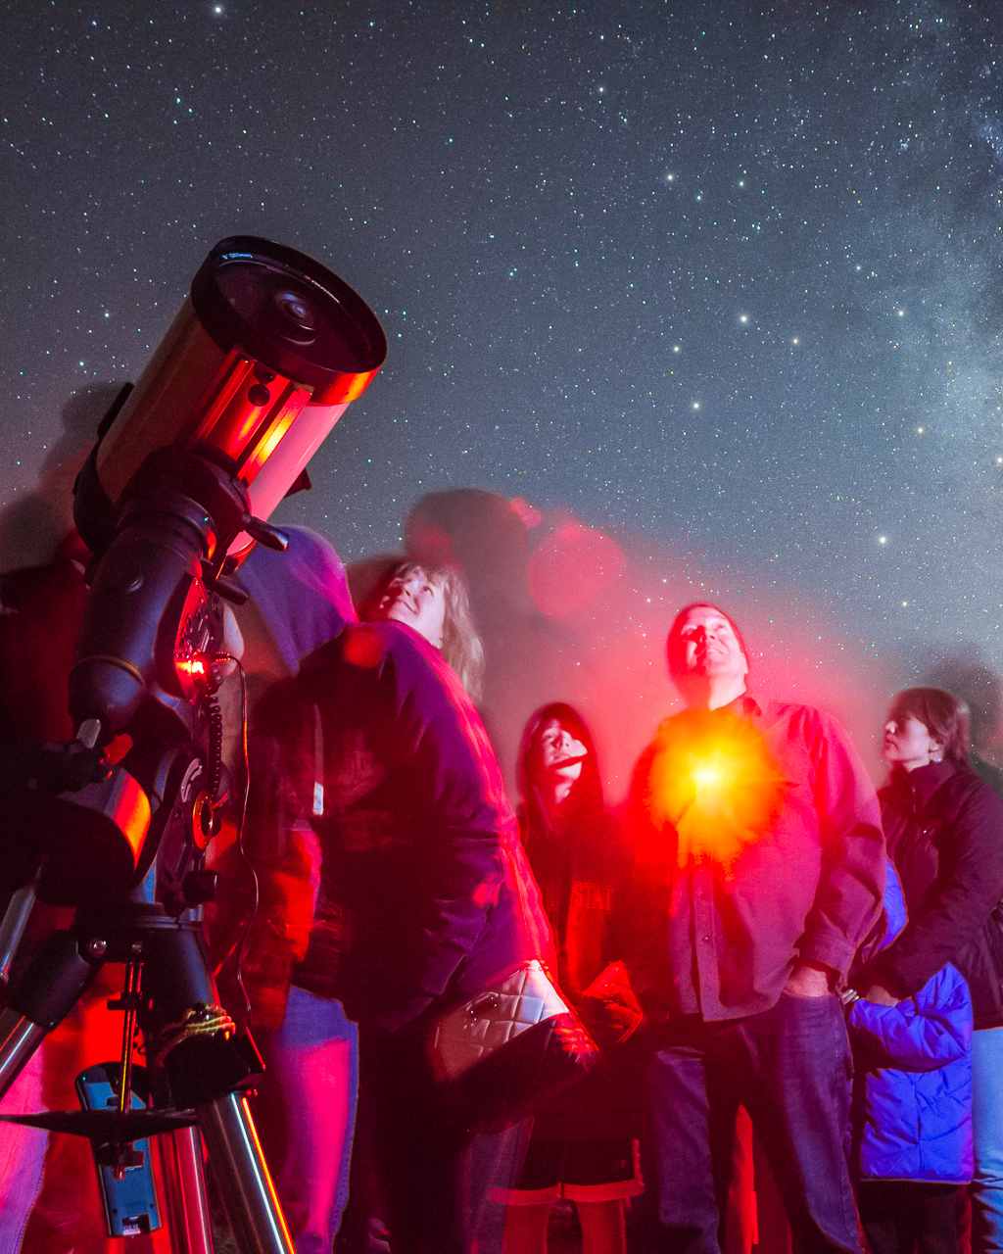
Community Outreach
Shadowing a Public Program Educator through Lowell Observatory’s Public Programs
Shadowing a Lesson through the Native American Astronomy Outreach Program (NAAOP) by Lowell Observatory
Shadowing a Public Night at the Barry Lutz Telescope at NAU
Flagstaff Astronomy Symposium
Scavenger Hunt through the
Flagstaff Festival of Science
Source: Flagstaff Star Party

Slide 7
Implementing the Course
Spring 2024

Slide 8
Student Information
Age
Race
66.7% of students are 22 or older
46.7% of students identify as white
Grade Level
Previous Sci Comm Experience
66.7% of students are seniors
46.7% of students had previous science communication experience
Gender
66.7% of students identify as male

Slide 9
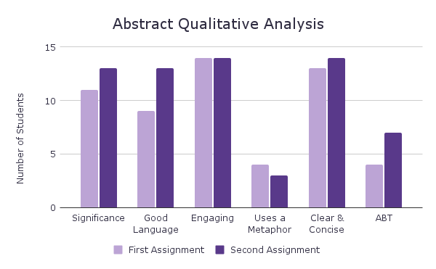
Written Practices
Assignments
250-Word Abstracts
Professional Article/Blog Post
Student Feedback
“I had to be creative in translating the jargon into layman's terms.”
“If I think about [my topic] in that ABT format it becomes a lot easier to write”
Overall Thoughts
Students are very successful with the written assignments
  Less emphasis on them in the future
Figure 1: A qualitative analysis of the students first and second 250-word abstracts. Students have gotten better at communicating their topic’s significance, using good language, and incorporating the ABT format

Slide 10
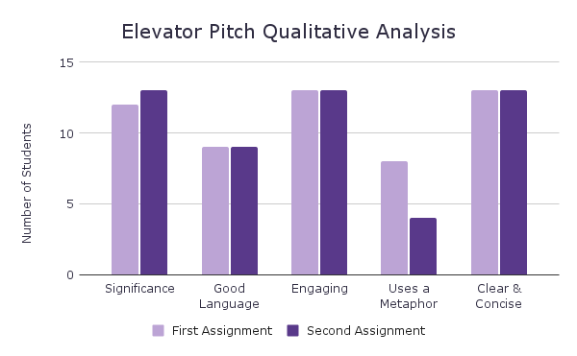
Oral Practices
Assignments
Elevator Speech
3-5 Minute Presentation
In Class Debate
Interview with an Astronomy Faculty Member
Student Feedback
A “good exercise on organizing thoughts and staying composed in front of others”
“I actually feel like I'm getting better at speaking in front of groups!”
Overall Thoughts
Students struggled more with these assignments
Seemed to be beneficial as a practice space
Figure 2: A qualitative analysis of the students first and second elevator pitch. Students have gotten better at communicating their topic’s significance.

Slide 11
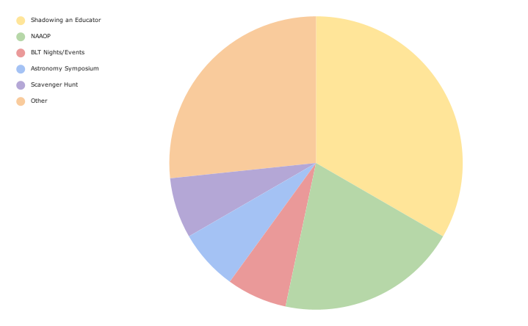
Activities and Public Engagement
Assignments
Community Outreach
Participation in Class
Student Feedback
“…it's not just about what you say but HOW you say it”
“Effectively communicating science is important because it might make an impact on a young mind one day and change their life.”
Overall Thoughts
Students have enjoyed the activities we have provided
Might include more that don’t take place on just the weekends or happen at different times
Shadowing a Public Program Educator
NAAOP
BLT Nights/Events
Astronomy Symposium
FFS Scavenger Hunt
Other
Figure 3: Activities student selected to do/did for community outreach. Majority of students shadowed a Public Program Educator or did an activity we hadn’t originally offered.

Slide 12
Course Reflection
Spring 2024

Slide 13
Future Courses
Continued emphasis on oral practices, as there is less space for that to be incorporated in other courses
Broader range of community outreach activities
Incorporating more in class activities for hands on practice as opposed to lecturing

Slide 14
Acknowledgements
For their participation in our course as a guest speaker: Dr. Peter Frederichi, Dr. Christina Thomas, Dr. Chad Trujillo, Nena Bloom, and Lauren Shollenberger
For their support with our community outreach opportunities: Jason Sanborn, Kevin White, Kevin Conley, Todd Gonzales, Scott Nelson, Juan Ruiz, Misha Pipe, Gavin Moriarty, and Elizabeth Vogler
For their help during the grant process: Dr. Mark Salvatore
For our students: Hunter Brooks, Fern Carter, Zia Clark, Virginia Crook, Jarod Despain, Erin Evans, Jadyn Fisher, Hayden Green, Max Hood, Jack Kohm, Ryan Milligan, Moraa Morara, Aliya Rhodes, Jay Wiley, and Riley Williams
Funding for this project is from the Hooper Undergraduate Research Award and the Arizona NASA Space Grant

Slide 15
Resources
“What is Career Readiness?”. National Association of Careers and Employers. https://www.naceweb.org/career-readiness/competencies/career-readiness-defined/.
Olson, R. (2015). Houston, We Have a Narrative. University of Chicago Press.
Reincke, C. M., Bredenoord, A. L., & van Mil, M. H. (2020). From deficit to dialogue in science communication: The dialogue communication model requires additional roles from scientists. EMBO reports, 21(9), e51278. https://doi.org/10.15252/embr.202051278

Slide 16
Thank You!

Slide 17
Student Learning Outcomes (SLO)
01
Learn the essence of research steps through communication in science
02
Communicate astronomy/science with various creative and engaging methods
03
Explain (complex and advanced) topics in astronomy/science to a general audience effectively
04
Critique the importance of good astronomy/science communication
05
Practice inclusive and accessible astronomy/science communication

Slide 18
Grading Information
Grading for Submitted Assignments
TA will appropriately assign points for the assignment
Will email students individually with feedback on said assignment
Does not deduct points for lateness
Grading for In Class Assignments
Using Peer Review function in Canvas students will grade other students' presentations/assignments in class
TA will average the points assigned by each student and instructor to get the overall grade for the assignment
Done for most oral practices' assignments

